Slide 1
Use Case Modeling

Slide 2
Objectives
To review use case modeling
  Actors
  Use cases
  Dependency relationships between use cases
  Use case diagrams
  Documenting use cases

Slide 3

Actors
An actor is anyone or anything that must interact with the system.
Actors are NOT part of the system
In the UML, an actor is represented as a stickman.

Slide 4
Use Cases
A use case is a description of a set of sequences of actions, including variants, that a system performs to yield an observable result of value to an actor.
A use case describes what a system does but it does not specify how it does it.
A use case typically represents a major piece of functionality that is complete from beginning to end.

Slide 5

Use Cases (Cont’d)
A use case must deliver something of value to an actor.
The collection of use cases for a system constitute all the defined ways the system may be used.
In the UML, a use case is represented as an oval.

Slide 6
Use Case Diagrams
A use case diagram is a diagram that shows a set of use cases and actors and their relationships.
Actors may be connected to use cases only by association.
An association between an actor and a use case indicates that the actor and the use case communicate with one another, each one possibly sending and receiving messages.
Use case diagrams are used to …
  Model the context of a system.
  Model the requirements of a system

Slide 7
Dependency Relationships between Use Cases
extend
  An extend relationship defines that instances of a use case may be augmented by some additional behavior in an extended use case.
include
  An include relationship implies that the behavior in the additional use case is inserted into the behavior of the base use case.

Slide 8
ATM: Problem Description
A bank has several automated teller machines (ATMs), which are geographically distributed and connected via a wide area network to a central server. Each ATM machine has a card reader, a cash dispenser, a keyboard/display, and a receipt printer. By using the ATM machine, a customer can withdraw cash from either a checking or savings account, query the balance of an account, or transfer funds from one account to another. A transaction is initiated when a customer inserts an ATM card into the card reader. Encoded on the magnetic strip on the back of the ATM card are the card number, the start date, and the expiration date. Assuming the card is recognized, the system validates the ATM card to determine that the expiration date has not passed, that the user-entered PIN (personal identification number) matches the PIN maintained by the system, and that the card is not lost or stolen. The customer is allowed three attempts to enter the correct PIN; the card is confiscated if the third attempt fails. Cards that have been reported lost or stolen are also confiscated.

Slide 9
ATM: Problem Description (Cont’d)
If the PIN is validated satisfactorily, the customer is prompted for a withdrawal, query, or transfer transaction. Before a withdrawal transaction can be approved, the system, determines that sufficient funds exist in the requested account, that the maximum daily limit will not be exceeded, and that there are sufficient funds at the local cash dispenser. If the transaction is approved, the requested amount of cash is dispensed, a receipt is printed containing information about the transaction, and the card is ejected. Before a transfer transaction can be approved, the system determines that the customer has at least two accounts and that there are sufficient funds in the account to be debited. For approved query and transfer requests, a receipt is printed and the card is ejected. A customer many cancel a transaction at any time; the transaction is terminated and the card is ejected. Customer records, account records, and debit card records are all maintained at the server.

Slide 10
ATM: Problem Description (Cont’d)
An ATM operator may start up and close down the ATM to replenish the ATM cash dispenser and for routine maintenance. It is assumed that functionally to open and close accounts and to create, update, and delete customer and debit card records is provided by an existing system and is not part of this problem.

Slide 11
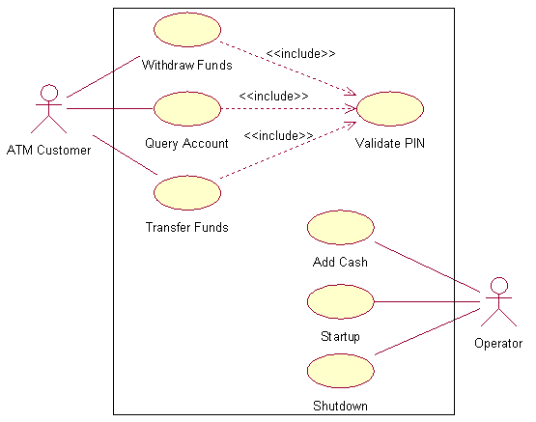
ATM: Use Case Model

Slide 12
Documenting Use Cases
Use case name
  Each use case is given a name.
Summary
  A brief description of the use case, typically one or two sentences.
Dependency
  Description of whether the use case depends on other use cases, that is, whether it includes or extends another use case.
Actors
  Names of the actors that participate in the use case

Slide 13
Documenting Use Cases (Cont’d)
Preconditions
  One or more conditions that must be true at the start of the use case
Description
  Description of the main sequence of the use case, which is the most usual sequence of interactions between the actor and the system.
Alternatives
  Description of alternative branches off the main sequence.
Postcondition
  Condition that is always true at the end of the use case if the main sequence has been followed.

Slide 14
Example 1: Validate PIN Use Case
Use case name
  Validate PIN
Summary
  System validates customer PIN.
Actor
  ATM Customer
Precondition
  ATM is idle, displaying a Welcome message.
Description
  Customer inserts the ATM card into the Card Reader.
  If the system recognizes the card, it reads the card number.
  System prompts customer for PIN number
  Customer enters PIN
  System Checks the expiration date and whether the card is lost or stolen.
  If card is valid, the system then checks whether the user-entered PIN matches the card PIN maintained by the system.

Slide 15
Example 1: Validate PIN Use Case (Cont’d)
  If PIN numbers match, the system checks that accounts are accessible with the ATM card.
  System displays customer accounts and prompts customer for transaction type: Withdrawal, Query, or Transfer.
Alternatives
  If the system does not recognize the card, the card is ejected.
  If the system determines that the card date has expired, the card is confiscated.
  If the system determines that the card has been reported lost or stolen, the card is confiscated.
  If the customer-entered PIN does not math the PIN number for this card, the system re-prompts for the PIN.
  If the customer enters the incorrect PIN three times, the system confiscates the card.
  If the customer enters Cancel, the system cancels the transaction and ejects the card.
Postcondition
  Customer PIN has been validated.

Slide 16
Example 2: Withdraw Funds Use Case
Use case name
  Withdraw Funds
Summary
  Customer withdraws a specific amount of funds from a valid bank account.
Actor
  ATM Customer
Dependency
  Include Validate PIN abstract use case
Precondition
  ATM is idle, displaying a Welcome message.
Description
  Include Validate PIN abstract use case.
  Customer selects Withdrawal, enters the amount, and selects the account number.
  System checks whether customer has enough funds in the account and whether the daily limit will not be exceeded.

Slide 17
Example 2: Withdraw Funds Use Case (Cont’d)
  If all checks are successful, system authorizes dispensing of cash.
  System dispenses the cash amount.
  System prints a receipt showing transaction number, transaction type, amount withdrawn, and account balance.
  System ejects card.
  System displays Welcome Message.
Alternatives
  If the system determines that the account number is invalid, it displays an error message and ejects the card.
  If the system determines that there are insufficient funds in the customer’s account, it displays an apology and eject the card.
  If the system determines that the maximum allowable daily withdrawal amount has been exceeded, it displays an apology and ejects the card.
  If the ATM is out of funds, the system displays an apology, ejects the card, and shuts down the ATM.
Postcondition
  Customer funds have been withdrawn.

Slide 18
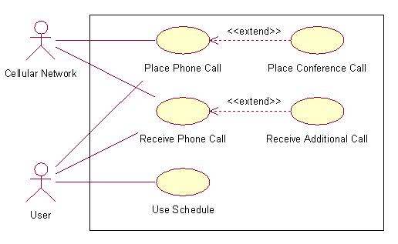
Cell Phone System: Use Case Model

Slide 19
References
G. Booch, J. Rumbaugh and I. Jacobson, The Unified Modeling Language User Guide, Addison-Wesley, 1999.
H. Gomaa, Designing Concurrent, Distributed, and Real-time Applications with UML, Addison-Wesley, 2000.
T. Quatrani, Visual Modeling with Rational Rose and UML, Addison-Wesley, 1998.

